Slide 1
Presentation of the Learning Areas

Slide 2
Education through sport
UPSDA and Prison of Stara Zagora (Bulgaria)
Emilia Crushcov & Nelly Basamakova
UPSDA

Slide 3
Why are we using sport?
Notes:
We are using sport and art to improve people’s skills.

Slide 4
We lift people UP
Our mission is to assist organizations and individuals in achieving professional and personal excellence.
Notes:
Our mission is to assist organizations and individuals in achieving professional and personal excellence.

Slide 5
Our goals are to:
Acknowledge the transversal and specific skills, developed by inmates through sport activities in order to improve social integration.
Highlight the social work that sport companies could carry out in penitentiary institutions.
Creating an innovative network system of socio-economic agents and labour market public offices through the sports clubs, federations and NGO’s that could improve the employability of ex-prisoners and/or facilitate social inclusion and empowerment of ex-prisoners once outside detention.

Slide 6
How are we using sport?

Slide 7
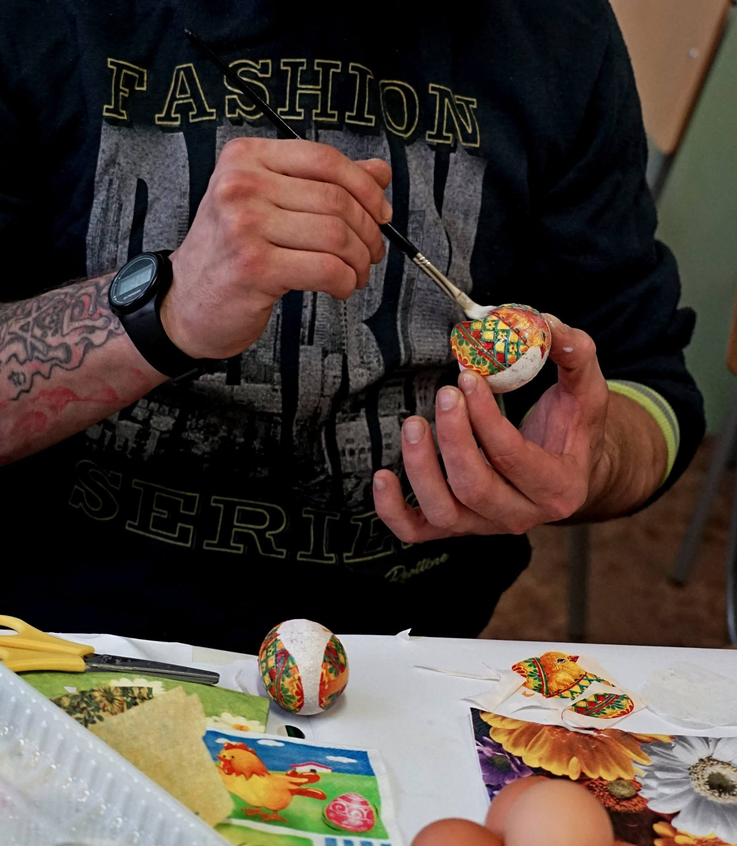
Developing and delivering of specialized rehabilitation programs
Offering new Experiences
Development and supporting of different skills and competences
Improved chances on the labor market
Lower recidivism rates
Using sport, art and other attractive and uninvasive tools
Notes:
Theatre and art activities in the Bulgarian prison are informal and voluntary. They are not considered a serious activity, but rather a way to pass the time or as and addition to certain holiday celebrations. There is not active work for acquiring artistic skill or competencies in terms of professional growth. Most inmates conduct some cultural or artistic activities, but they are not reported as it depends on the desire of the prisoner and is not in relations to The Ministry of Justice.
ARTISTIC WORK:
Performing for public audience
Language skills, (Self-)Presentation in Public,
Playing different roles
Reading, learning und speaking of complexes, artistic textes
Careful handling with different materials
Writing own textes
Learning to learn: doing homework, memorizing, repeating
SOCIAL SKILLS
Discipline / interpersonal Skills / trustness / self-esteem,
Acceptance of other Cultures / intercultural Skills
Critical Thinking
Creative Thinking
Competences to use leisure in a new way
Time-Management
TEAMWORK:
Helping & supporting others
Conflict management
Control of aggressions
Doing a project with people who had no truck with each other before
Breaking prejudices
Tolerance in contact with other cultures, positions & ideas
OTHER:
Succesfully achieving to create a project from start to finish
Motivation to create other projects
Be able to estimate the own skills & competences
To take responsibility
Coaching in interacting with press /media /social media
Certification: every participant will get a certification and a portfolio, which explains the project and his personal role in this work. This Certification shows the skills and competences, which the participants gained in this project and it should help him to get better chances at the labour marked in Bulgaria and in Europe.

Slide 8
What are our actual activities?

Slide 9
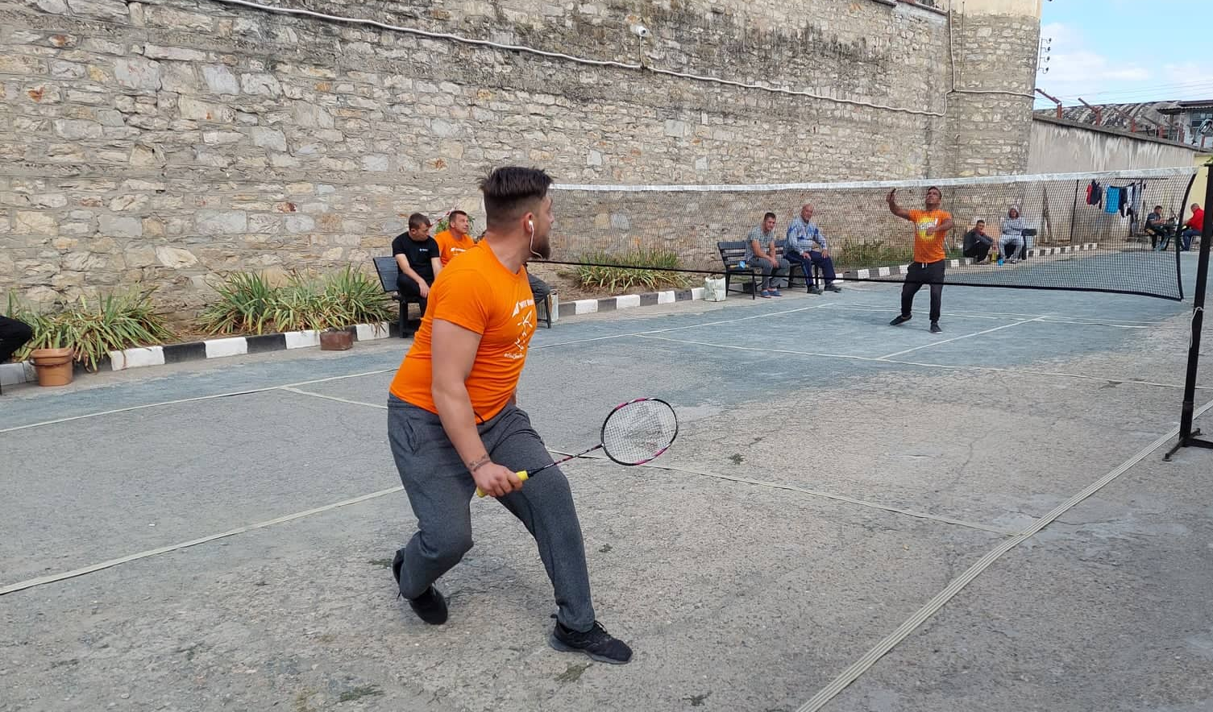
БАДМИНТОН

Slide 10
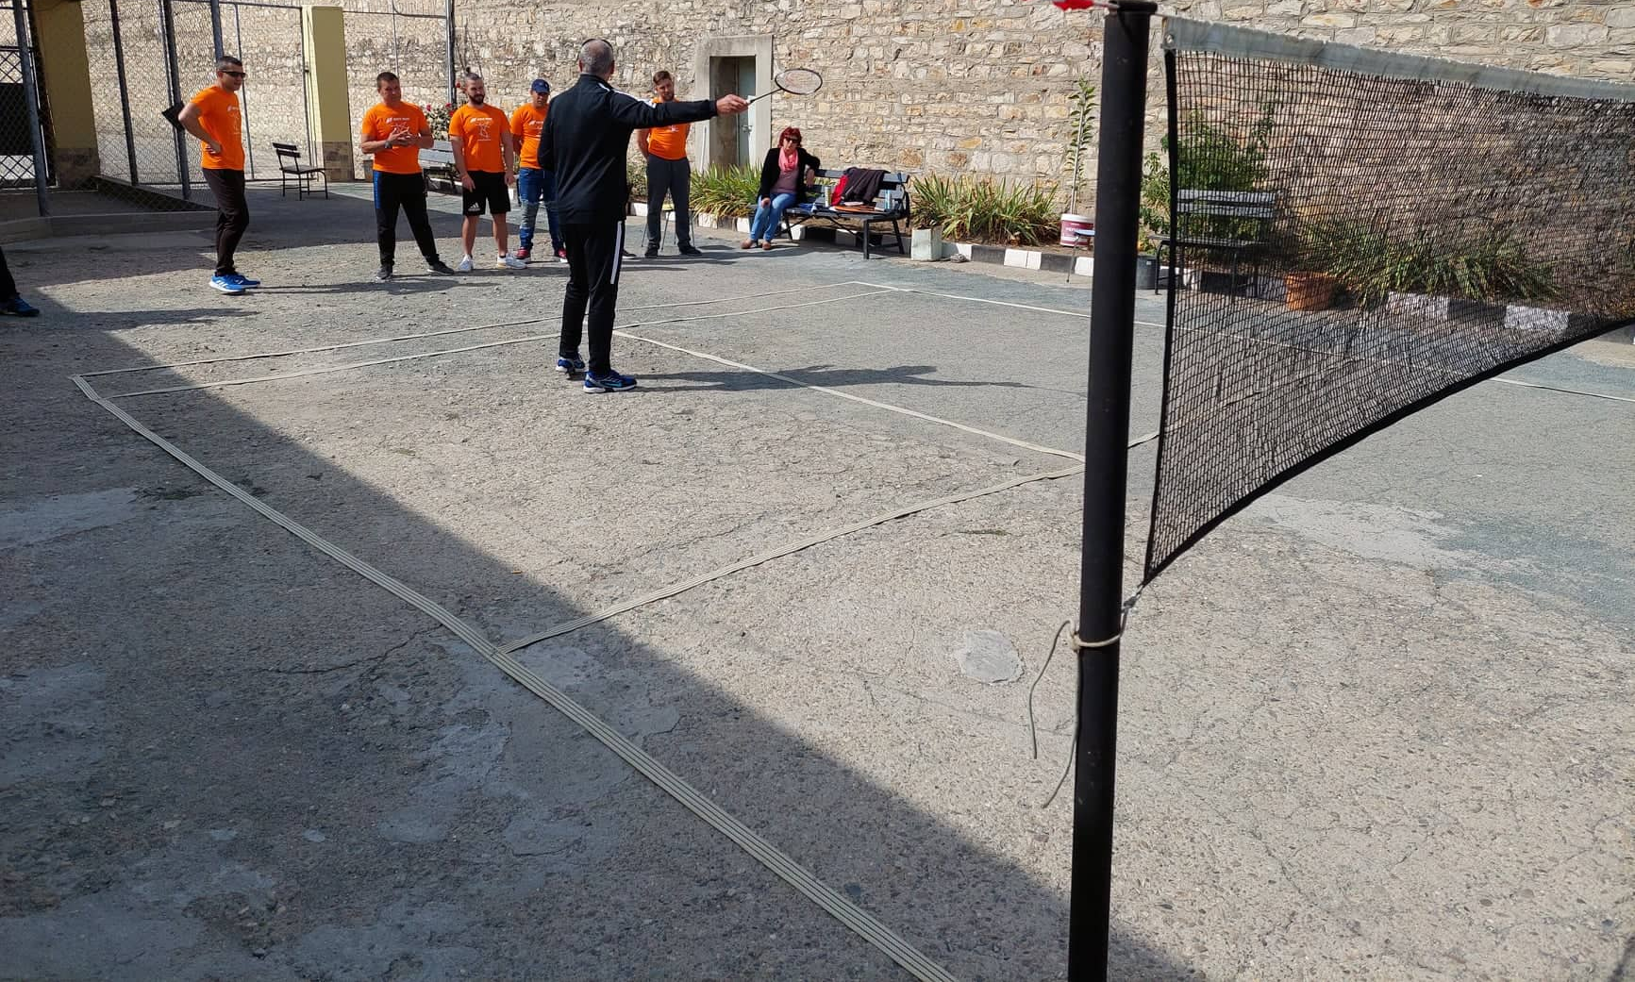
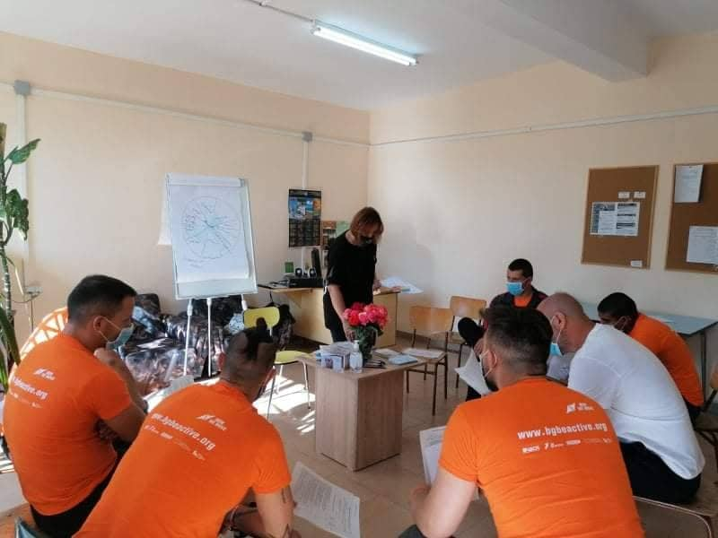
Activities in the Prison of Stara Zagora, Verea – open type dormitory
2
1
Frequency of sport activities:
Minimum 2 times a week over a period of 6 to 8 months + additional and complimentary activities and support (individually or as a group)
Notes:
Education trhough sport program explained

Slide 11
Activities with an educational approach: Education Through Sport (ETS)
Voluntary;
Accessible (ideally);
An organised process with educational objectives;
Participatory and learner-centred;
About learning life skills and preparing for active citizenship;
Based on involving both individual and group learning with a collective approach;
Holistic, multidisciplinary and process-oriented;
Based on experience and action, and starts from the needs of the participants .

Slide 12
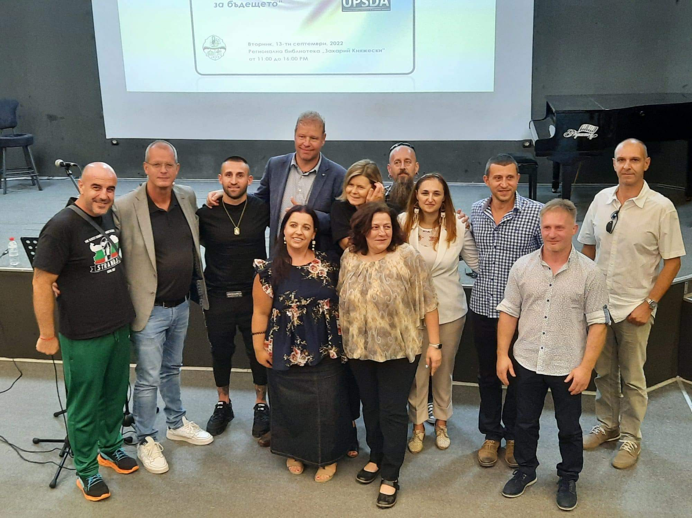
Outcomes
Literacy skills: reading, writing, speaking;
Intrapersonal and interpersonal skills (self-management and self-control, communication, teamwork, diversity awareness, learn to learn, lifelong learning skills);
Public speaking;
Conflict management and negotiating skills;
Problem-solving skills;
Gathering data skills and skills for validating information;
Lateral thinking skills;
Consequential thinking;
Perspective taking skills;
Event planning.

Slide 13
UPSDA network activities and process:
Engage the network of UPSDA partners and the prison staff via TOT training
Engage participation of inmates in the decision-making and planning new ‘sport plus’ and ‘plus sport’ activities and programs
Engage the inmates in the actual program, using badminton as a main activity and input from different coaches and trainers for social skills. The main trainer and leader of the program was a detainee
Job readiness workshops and follow up support with personal and career development plans
Engage prison staff and UPSDA network of professional to increase the social impact for prisoners through making links with the ‘outside world’ and match the inmates with future employers
Evaluate and map a structured model for sport operators, willing to provide meaningful sport activities in prison as well as support in the community upon release of the inmates
Distribute the guide and know-how
Multiply the existing good practices from Prison of Stara Zagora to other prisons, taking into consideration the local settings and involving new operators from sport clubs and NGO’s, as well as volunteers outside the prison

Slide 14
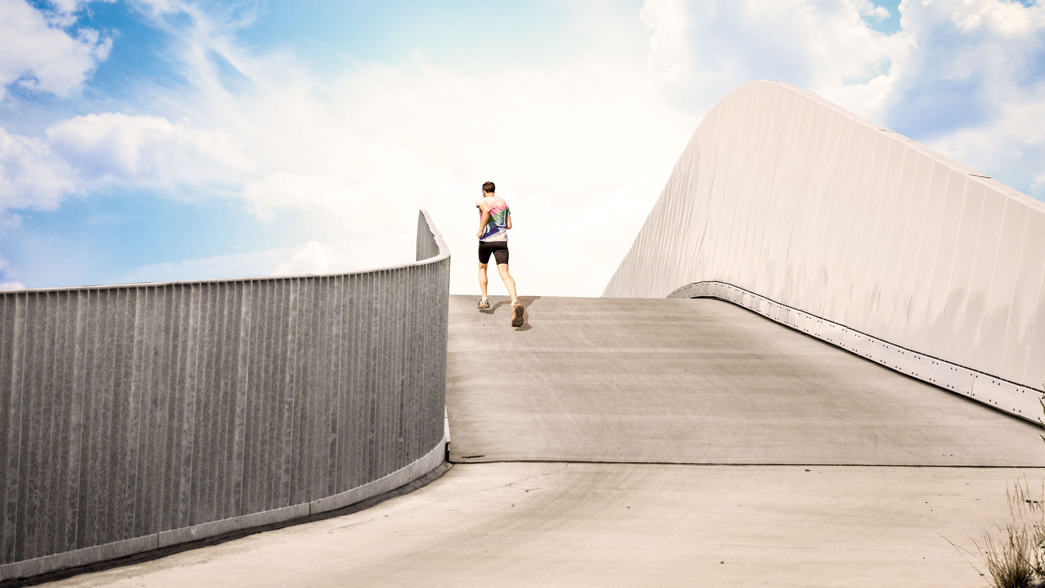

Slide 15
Powerful mind, even more powerful body
Turopolje Educational Institution (Croatia)
Lucija Zivkovic & Anamarija Tadic
UKSR

Slide 16
Why are we using sport?

Slide 17
Why are we using sport?
Prisoners see sport as a way to vent frustrations, to release tensions and to achieve a pumped-up image that would secure them respect in prison
Prison staff see it as a way to keep the prisoners occupied and to prevent incidents that occur when they are idle

Slide 18
Why are we using sport?
We in ACSW see sport as a way to secure prisoners’ wellbeing and to improve their health, as well as to connect with their surrounding in prison and after they are released
Objectives are:
To create habits to exercise regularly in a way that would enhance prisoners’ wellbeing during sentence (to avoid injuries and strain)
To raise awareness and to inform prison authorities throughout Croatia and policymakers about the benefits of sport activities aiming at creating connections of prisoners with the outside world

Slide 19
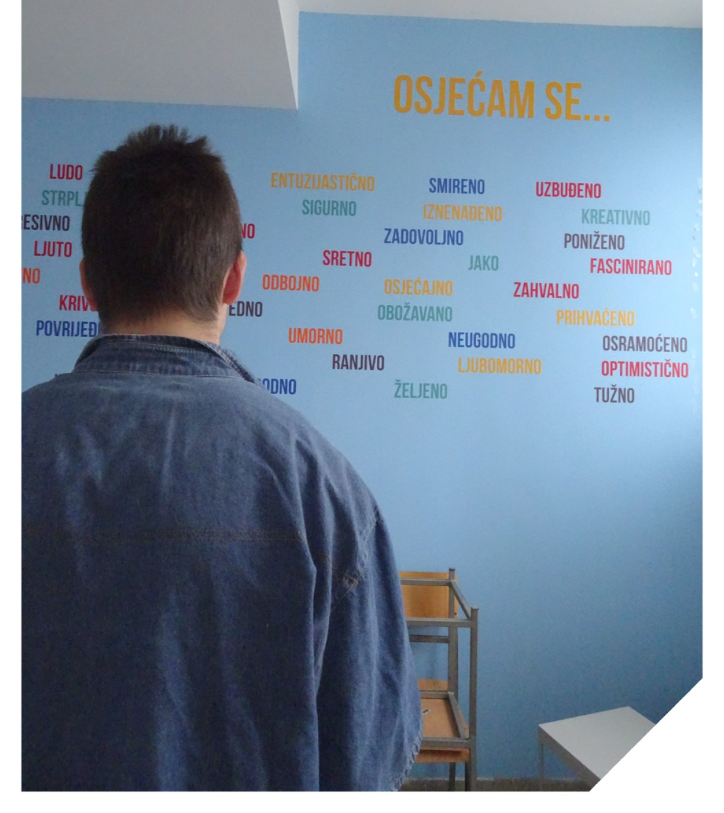
Wall of emotions – educational workshops

Slide 20
How are we using sport?

Slide 21
How are we using sport?
Our goal was violence prevention among youth in Turopolje Educational Institution. To achieve that goal, we were using crossfit trainings for:
Improvement of physical capacities
Forming a habit
Improving self-control
Improving mental health
Minimizing aggressive behavior
Other sport workshops were aiming at collaboration and learning among users (for example – street workout and exercise in cells).

Slide 22
What are our actual activities?

Slide 23
What are our actual activities?
Advocacy and capacity building: workshops for (1) policymakers, (2) prison treatment and management staff, (3) stakeholders outside the justice system
Social skills workshops for detainees accompanying sport trainings:
50 crossfit trainings (circular trainings)
7 educational workshops with the following themes:
- familiarizing with the program and managing expectations
- effective communication
- emotional learning
- stereotypes and prejudice
- conflicts
- conflict resolution
- values, lifestyle choices and goal setting
Equipment provision – street workout equipment
Establishment of post-penal support through sport

Slide 25
Thai Boxing for adolescents and young adults
Sempre Avanti sport club (Italy)
Camilla de Concini & Daniela Conti
UISP

Slide 26
Why are we using sport?

Slide 27
Why are we using sport?
The intention is to create inclusion/integration by giving young people from diverse backgrounds the opportunity to play a sport together
The choice of Thai Boxing was strongly related to our objectives:
an excellent hook for young people
an individual sport practiced in competition/relationship with the other in a group context
Individual level
Working with emotions
Personal resources
Sparring partner
Control and manage impulse - Regulate intensity
Collective level
Peer education - Responsibility
Role models

Slide 28
Why are we using sport?
These peculiar characteristics of Thai Box, allowed us to create common strategies of integration and relational exchange.
Thai Box training is:
A safe space where participants can experiment playfully
A time where to work on relationships, emotions, and skills
A moment of capacity building where each participant was driven by interest
A source of psycho-physical well-being
Provides a habit to discipline in daily life

Slide 29
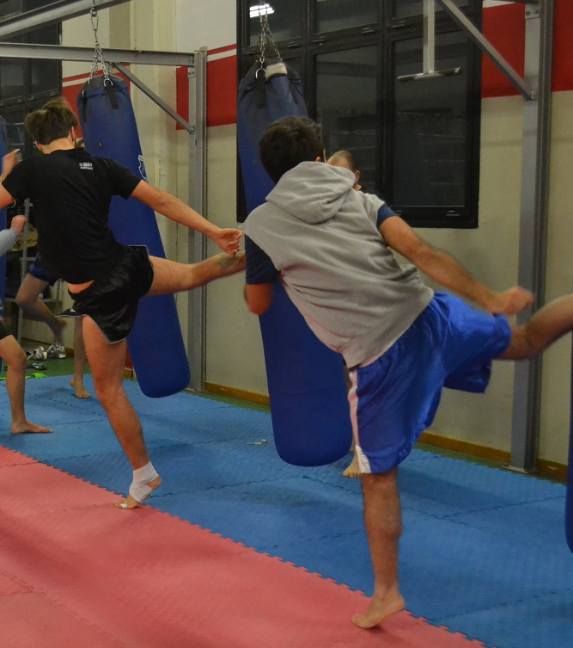
Teenagers from the under 21 Thai Boxing group, training together in Sempre Avanti Club Bologna

Slide 30
How are we using sport?

Slide 31
How are we using sport?
3 times a week, for 10 months
2 different age groups (6-12 and 13-21)
Thai Boxing lessons
led by two martial arts trainers with a socio-pedagogical background
50 young people,
25 from the Centre for Juvenile Justice and 25 enrolled by families

Slide 32
How are we using sport?
Creating an educational community.
Each student received special attention to create a climate of trust. Only with trust we can begin the process of growth and change.
In each class we worked on building respect for the rules.
The approach always remained welcoming and non-judgmental, considering the vulnerability of each participant, with the aim of avoiding losing the contact made.
Working on the meaning and importance of one’s actions: building/acquiring a new skill/competency, and emphasizing each step in the process of achieving a goal.

Slide 33
What are our actual activities?

Slide 34
What are our actual activities?
Spread the results of this activity and sensitize institutions and public opinion
Strengthen the collaboration with local institutions and social services
Find new funds to bring on the activity
Give continuity to the activity with a new project involving mother prisoners and their children
Advocate to bring Thai Box inside prisons

Slide 36
FC Emmen Inside
Veenhuizen Prison (Netherlands)
Bert Koops & Gerko Brink
Dienst Justitiële Inrichtingen

Slide 37
Why are we using sport?

Slide 38
Why are we using sport?
The goal is to let detainees work on the eleven core values ​​of FC Emmen and that after detention they can get a paid job through the network of sponsors/businessclub of FC Emmen.
Sport unites, sport activates, and sport brings people together!

Slide 39
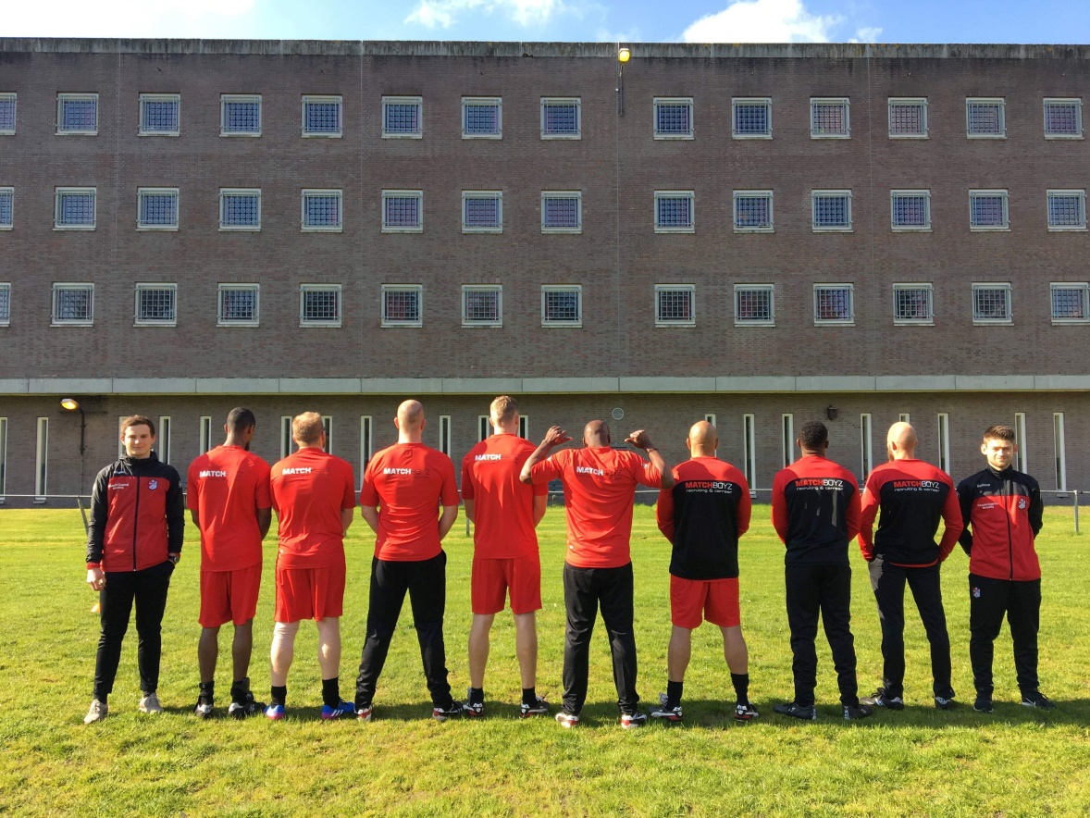
10 to 16 prisoners who want to work on their life and working skills and/or who are looking for a job after detention.

Slide 40
How are we using sport?

Slide 41
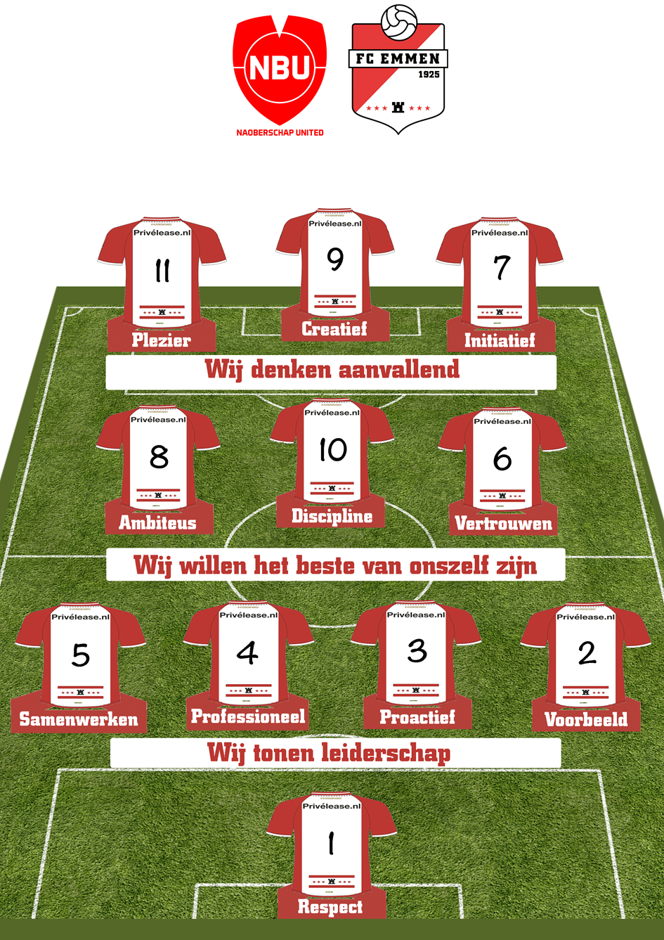
How are we using sport?
8 weeks in the prison of Veenhuizen
2 times a week
Trainer of FC Emmen and a
sports instructor of the prison
Working on the 11 values of FC Emmen:
- Respect - Discipline
- Pro-active - Ambitious
- Pleasure - Role model
- To Trust - Creative
- Initiative - Professional
- Working Together

Slide 42
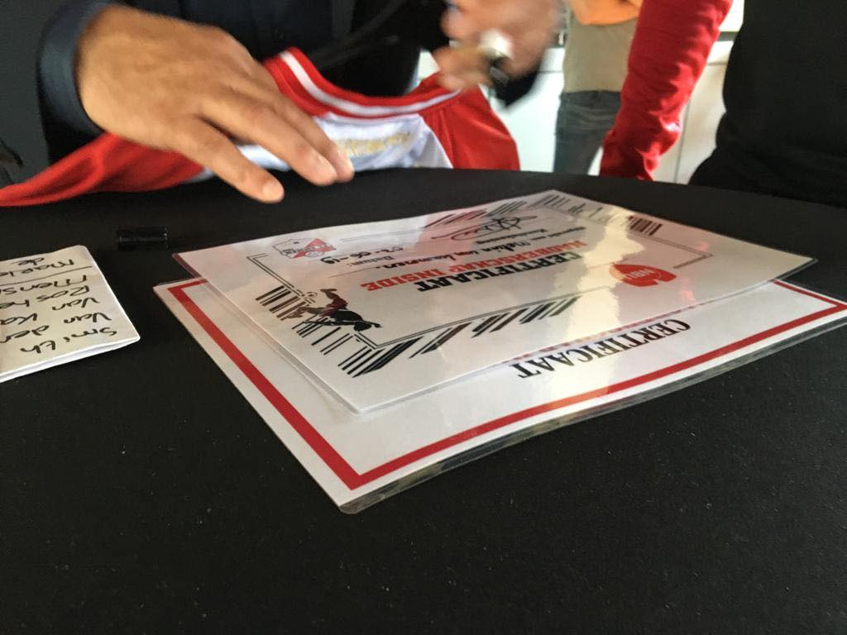
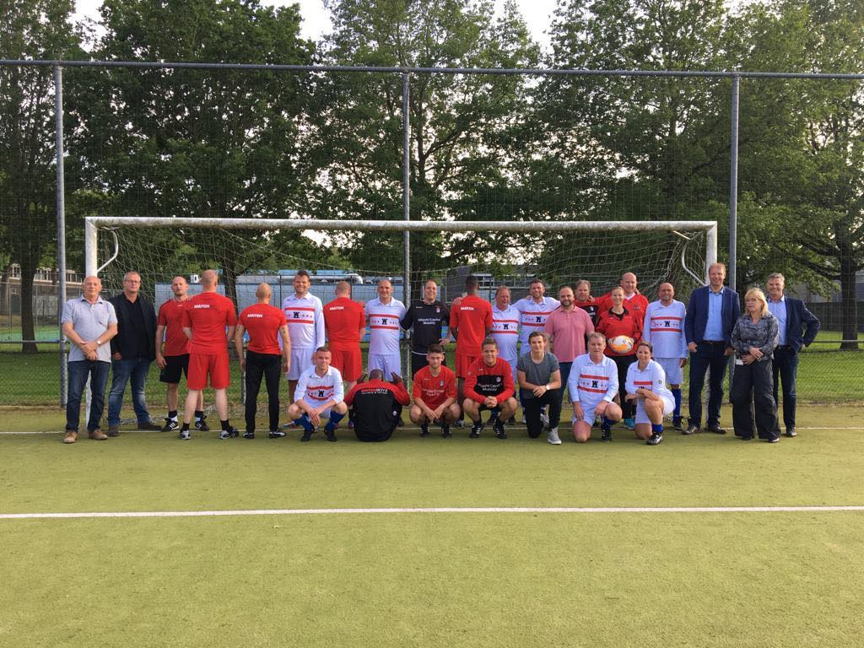
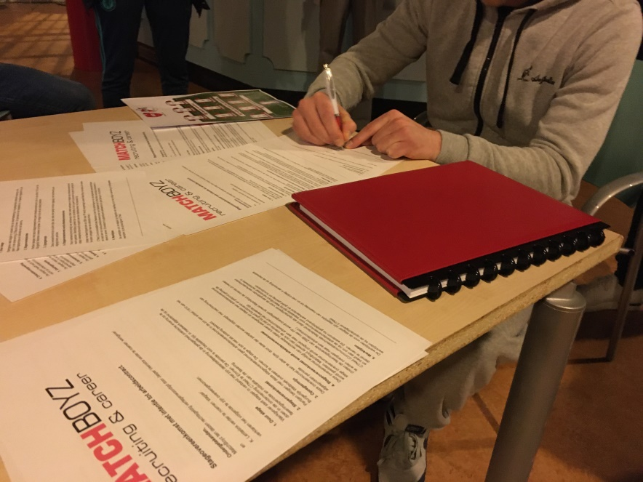
How are we using sport?
All participants receive a clothing package of FC Emmen
Preparation for paid work to fill in CV, worksheet about their skills and intakes with potential employers
In week 9, they play a game against the business club and first contracts are signed for a paid job

Slide 43
What are our actual activities?

Slide 44
What are our actual activities?
2 projects a year
4 projects total with 38 prisoners who obtained a certificate and 19 prisoners who obtained a paid job
Be an example for other football clubs and prisons in Holland:

Slide 45
What are our actual activities?
Be an example for other football clubs and prisons in Europe by starting the new Erasmus+ project ‘Football Works’ on 1 January 2023

Slide 47
Start To Coach
Beveren Prison (Belgium)
Going For Goals
Hasselt Prison (Belgium)
Gino Campenaerts & Nele Vanderstraeten
De Rode Antraciet

Slide 48
Why are we using sport?

Slide 49
Why are we using sport?
Start To Coach
We believe that football clubs and sports associations in a whole can make an important difference within a socially inclusive narrative and the individual development of the participant.
By developing sport programs with a social impact and a connection with society or the ‘outside world’, prisoners will find the mental oxygen to restore faith in themselves and in others. They can work on a positive self-image and a valuable identity perception, for example by developing their talents or strengthening their relationships with others.

Slide 50
Why are we using sport?
Going For Goals
Sport is a universal language. As a physical activity, sport deals with cultural and linguistic differences. Sport - as a physical outlet - provides relaxation, has a positive impact on mental and physical health, contributes to the well-being and self-development of the participants. Sport brings people together and gives the participants the opportunity to be part of a team. It creates a sense of belonging and helps them to practice their social skills. It is a lever of social inclusion. In the program ‘Going For Goals’, the target group are prisoners below the age of thirty who are on remand or are short-term offenders. This target group slips through the cracks of the aid network, they do not make it through the waiting lists for their assistance. But two out three prisoners at Hasselt are participating in sports. It shows how important sports are to our target group. Sports are something where they can find themselves and like-minded people. It is a way for us to reach and connect to them.
We also believe that for successful reintegration, all life domains, must be addressed.

Slide 51
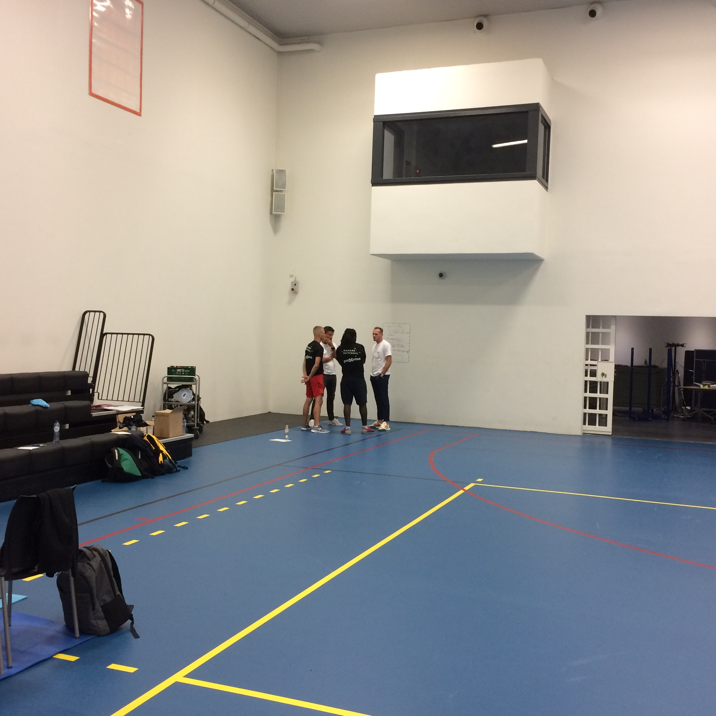
Start To Coach workshop – Beveren Prison

Slide 52
How are we using sport?

Slide 53
How are we using sport?
Start To Coach
Cooperation with the VUB, Voetbal Vlaanderen and participating clubs.
Involving the clubs early in the project (within the prison walls).
"coaching project“.
Preparing prisoners for their reintegration into society by developing social skills.
Becoming a UEFA youth football coach.
Certificate.
Putting the acquired knowledge into practice within the operation of a team outside the prison walls.
An internship within the participating clubs.
A full-fledged trainer within the participating clubs.
Follow-up program, start up (social and practical).

Slide 54
How are we using sport?
Going For Goals
Group sessions in a leisure atmosphere where we informally teach participants social skills, sporting skills and other competencies
We introduce participants to sports opportunities and support services during and after detention
Fully committed to engaging participants
We detect the needs of the participants in all life domains
Creating trust and safety within the group, towards the coach and the organizations
The assistance process is started during detention and can be continued after detention with the same coach and/or organization. Possibility for progression to an ICAN trajectory after detention:
An integral approach with a coach who takes on the role of 'route companion’ for 12 months
Bringing participants closer to work or daytime activities by removing barriers.
Cooperation with Arktos, CAW Limburg, VDAB, Justice department

Slide 55
Going For Goals workshop – Hasselt Prison

Slide 56
What are our actual activities?

Slide 57
What are our actual activities?
Start To Coach
A practical and a theoretical course of 8 weeks.
2 trainers of Voetbal Vlaanderen in collaboration with mentors/trainers of the participating clubs.
Development of social skills on the pitch and beyond.
Mentor of the Rode Antraciet vzw for the social part of the course.
16 participants joined the course and 16 finished the first part within the prison walls.
12 were allowed to start the second part.
The second part consisted of an internship within the participating clubs.
Up to 60 moments.
9 participants started the second part outside the walls.
3 are still waiting for approval from the SURB (early release court) to start.
Of the 9 participants, 4 started from prison using exit permissions and 5 from home during electronic surveillance.
The internship consisted of a weekly training in which participants were able to train children (9 to 11).
The internships were not paid.

Slide 58
What are our actual activities?
Going For Goals
Group Activities:
Weekly sport sessions
Weekly group sessions: a focus on informal learning and leisure
The content of the sport and group sessions are determined in a participant-driven manner
The participants will have the opportunity to take charge of the group or to provide their own training for the group
Individual conversations
Approximately every 6 weeks there are individual follow-ups
Discussion of the project, their participation in the project, and their probationary needs
A Going For Goals group meeting after detention: A sporting outlet and group support

