Slide 1
Literature - Survey
Marc Theeboom – Hebe Schaillée – Inge Derom

Slide 2
identification of sport activities in prisons in EU (literature review)

Slide 3
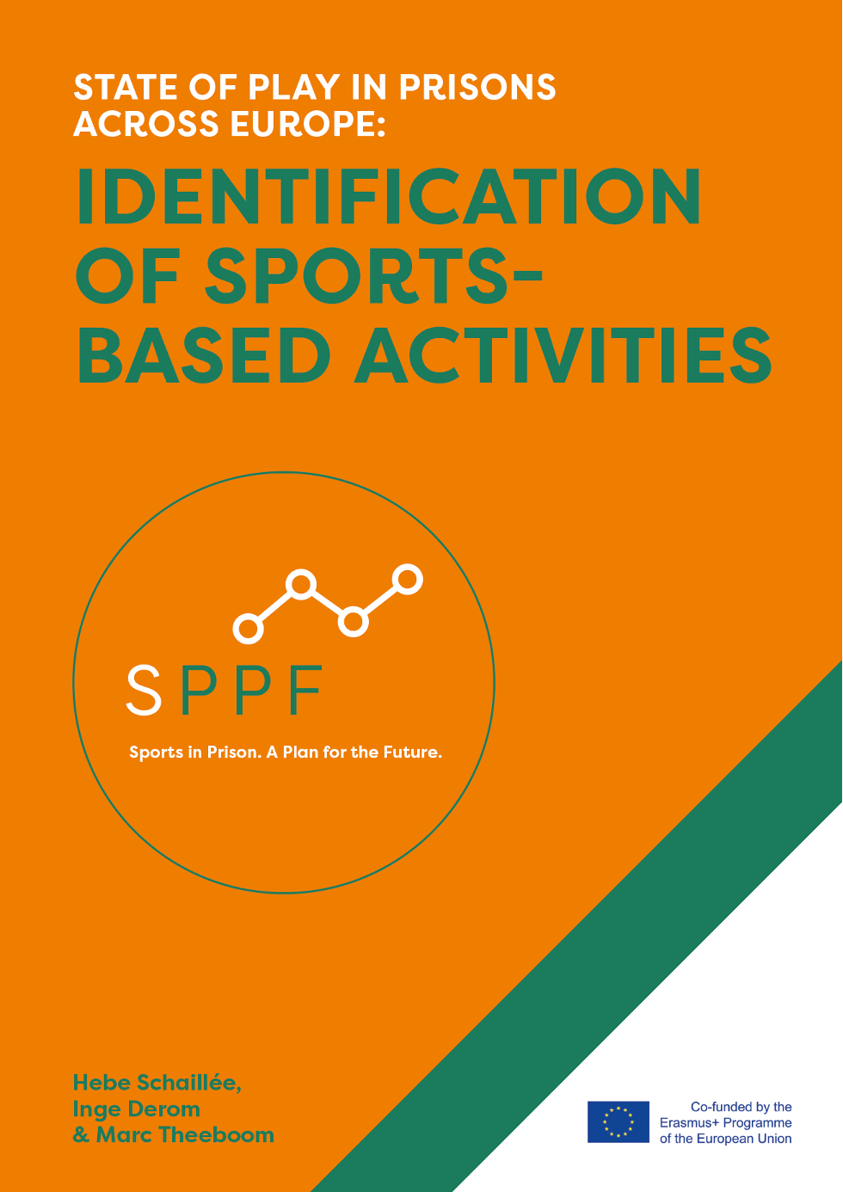
Objective
Mapping of existing practices in EU member states using sport activities to prepare prisoners for life after prison and that can have a link with the outside world
Review of the academic and non-academic literature (2010-2020)
https://saso.research.vub.be/sppf

Slide 4
Main findings
8 studies investigating if sport activities in prison can contribute to mental wellbeing, attitudinal and/or behavioural change of prisoners
reported variety in sports, research methods and measured outcomes
detailed information about the way the activities are organised is often missing
limited reference to a link with the outside world / ‘through the gate support’ is rarely provided
not all studies reported positive outcomes
unclear if measured outcomes were aligned with programme objectives

Slide 5
online survey

Slide 6
Respondents (N=198)
those working in prisons and involved in sport provision, in projects or working together with ex-prisoners in follow-up projects (prison staff, activity providers, sport organisations, social organisations…) and prison management
82.2 % were employed in SPPF partner countries
64% male
active in different regimes (mid to high security levels)
on-line survey was conducted between June and September 2020

Slide 7
Main findings
sport activities serve multiple objectives
other objectives are mentioned more frequently than ‘leisure’
Objectives | %
Health promotion (physical and mental wellbeing) | 80.9
Personal and social development | 77.8
Social integration | 68.3
Leisure | 61.1
Other (e.g., relaxation, emotional discharge) | 12.3
I don’t know | 1.0

Slide 8
a majority of the activities (71%) is organised permanently
a small number of all activities (14%) are dependent on external funding
participation is mostly voluntary (96%); half of the activities (49%) are organised once a week and 21% reported the existence of a waiting list
more than half of the respondents (58%) reported dropout by prisoners (e.g., because of loss of interest – 60%, relocation – 52%)
Is there a waiting list for the activity?
(N=293; RR=100%)

Slide 9
in about half of the activities (52%) there is an active involvement from prisoners in the organisation of the activities
Involvement from prisoners
Social skills perceived to be crucial

Slide 10
in more than two thirds of the activities (69%) prison staff is involved in the organisation
Type of partners | %
Sport organisation | 68.4
Social organisation | 44.9
Governmental organisation | 28.7
Private person | 19.1
Other (e.g., employment agency) | 19.1
I don't know | 1.5
less than half of the respondents (46%) indicated that they involve external partners for the organisation of the sport activities
20% reported to provide a follow-up activity outside of the prison

Slide 11
Is there an evaluation of the activity?
Who conducts the evaluation?
(N=293; RR=100%)
according to the respondents: prisoners highly value the sport activities (average 8/10)

Slide 12
some conclusions …

Slide 13
Research on the benefits of sport in prison settings exists (mainly in the UK), but remains scarce and has provided limited evidence or insights into the nature of actual interventions.
However, there are high expectations among the respondents of the survey regarding the role of sport in prisons and often go beyond direct sport-related outcomes.
While most respondents report positive feedback made by prisoners of the sport programmes, evaluation of these activities is mostly done by those delivering them and more than one third of the activities is not evaluated.

Slide 14
Almost half of the sport programmes targeting 'social inclusion’ do not involve external partners and only few of these programmes have follow-up activities outside the prison walls.

Slide 15
Limitations of this survey:
quantitative with no detailed analysis: no ‘probing’ (follow-up) questions: ‘why?’;‘how?’...
dependent on respondents’ willingness to collaborate (time consuming)
only providers (no prisoners)
willingness to be (self)critical?
language issues
mostly in ‘SPPF countries’
during COVID times
…
→ exploratory research in an Erasmus+ context
→ only scratching the surface…

Slide 16
what’s next …?

Slide 17
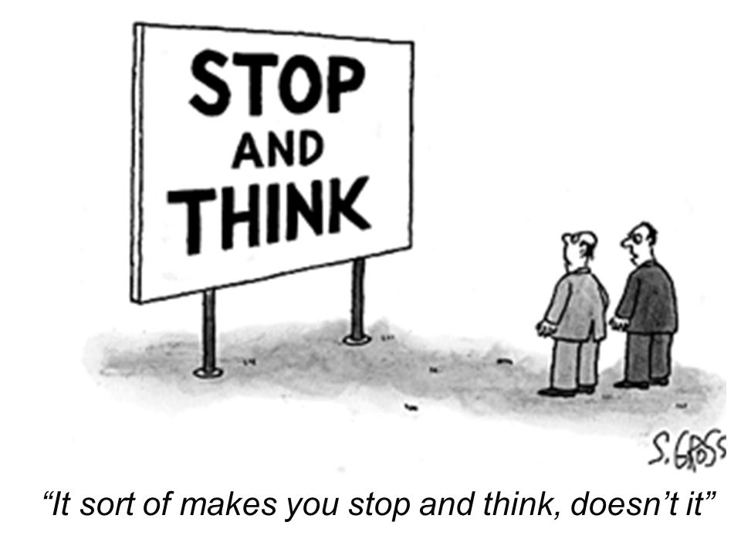

Slide 18
Using sport for broader social purposes is often being labelled as ’Sport for Development’ (SfD)
The SPPF project is clearly situated within SfD
Although the context of a prison setting is a very specific one, we noticed several similarities regarding the challenges that many SfD programmes are facing

Slide 19
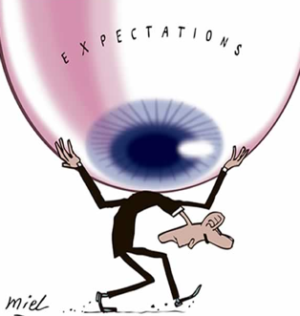
High expectations
“Because of the political processes of persuasion and negotiation that are required to get a program enacted, inflated promises are made in the guise of program goals … Holders of diverse values and different interests have to be won over, and in the process a host of realistic and unrealistic goal commitments are made.”
Weiss, C. (1993). Where politics and evaluation research meet. Evaluation Practice, 14(1), 93-106.

Slide 20
No clear descriptions of programmes and expected outcomes
“Ill-defined interventions with hard-to-follow outcomes”
Pawson, R. “Evaluating ill-defined interventions with hard to follow outcomes.” Paper given at ESRC Seminar, Defining and measuring the social impacts of sport and the arts. Leeds Metropolitan University, 22 January 2004.

Slide 21
Unclear role of sport…
as a means of recreation/leisure activity (‘sport’)
as a means of attraction (‘plus sport’)
sport is a ‘hook’ to attract participants (‘fly paper’) to introduce other activities
to facilitate relationship building between organisers and participants
as a means of development (‘sport plus’)
sport is an explicit experiential learning context aimed at producing broader (developmental) outcomes
additional activities with or without a link to the sport activities
Coalter, F. (2007). A wider social role for sport. Who’s keeping the score? Routledge, London.

Slide 22
A lack of sound research evidence
several deficiencies, such as:
a very generic perspective on sport with a lack of insight into differential effects of different activities;
limited causality testing;
no focus on the strength and duration of the effects or on the effects of frequency, intensity and duration of the sport participation;
limited descriptive or explanatory analysis of the interventions
Taylor, P., Davies, L., Wells, P. Gilbertson, J. and Tayleur, W. (2015) A review of the Social Impacts of Culture and Sport. The Sport Industry Research Centre and Centre for Regional Economic and Social Research (Sheffield Hallam University) and Business of Culture (BOC). Department for Culture, Media, and Sport CASE program: UK.

Slide 23
Importance of evidence …
→ evaluation
 | Initial plan | Implemented plan
Participants | Prisoners and non-sport partners | SPPF-partners (programme providers)
Approach | Pre-post survey and focus groups | Reflective practice via different reflective methods (written journals, reflective conversations with critical friends, online tool (‘impact wizard’),…)
Outcomes | Expectations, satisfaction and lived experiences | Visualisations of sports-based programmes for prisoners that focus on social integration

Slide 24
Importance of evidence …
→ evaluation
 | Initial plan | Implemented plan
Participants | Prisoners and partners | SPPF-partners (programme providers)
Approach | Pre-post survey and focus groups | Reflective practice via different reflective methods (written journals, reflective conversations with critical friends, online tool (‘impact wizard’),…)
Outcomes | Expectations, satisfaction and lived experiences | Visualisations of sports-based programmes for prisoners that focus on social integration
→ an alternative evaluation approach

Slide 25
Theory-Based Evaluation approach (TBE)
moving away from simple ‘input-output approaches’ towards an understanding of contexts, processes and outcomes

Slide 26
instead of merely investigating ‘if’ a programme or policy works (what most evaluative research does), TBE intends to understand ‘why’, ‘how’, ‘for whom’ ‘to what extent’ and ‘in what circumstances’ it does (or does not…)
what is the ‘logic’ or ‘theory’ behind a programme (intervention, project)?
‘Theory of Change’ (using a ‘logic model’)

