Slide 1
Keynote
Prof. dr. Haydn Morgan
University of Bath, UK

Slide 2
Key mechanisms in effective sport and criminal justice projects
Dr Haydn Morgan
Associate Professor
Department for Health
University of Bath, UK

Slide 3
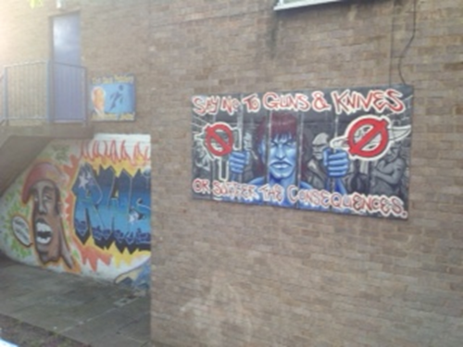
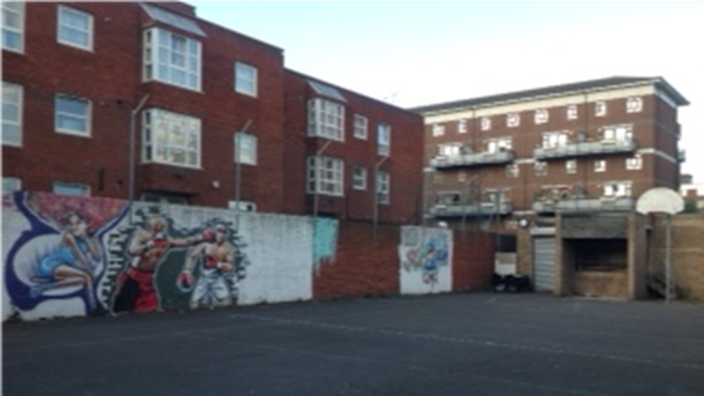

Slide 4
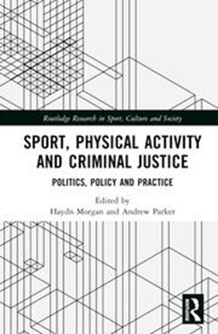
Sport, Physical Activity and Criminal Justice (Morgan & Parker, 2023)
Key aims:
Strengthen the evidence base surrounding sport and physical activity as a policy ‘instrument’
Think more critically about the potential of sport and physical activity interventions
Develop a more nuanced approach to the design of sport-based interventions

Slide 5
Key mechanisms
Delivery methods
Transferability of skills, attributes and competencies
Partnership working
Interpersonal relationships
Programme/Intervention staff

Slide 6
Key mechanism 1: Delivery methods
Limitations of a ‘deficit model’ approach
Focus on individual deficiencies
Steering away from ‘risk’
Only experts can help (disempowered and dependent young people)
Strengths-based approach (Paraschak and Thompson, 2014)
Individuals have acquired and demonstrated strengths
Individuals possess resources in their community that can enhance their strengths
Work with (not ‘on’) individuals to further develop their strengths

Slide 7
Key mechanism 2: Transferability
Moving from cliché to evidence
Accumulation of ‘capitals’ (Morgan et al., 2018; Morgan and Parker, 2021)
Human
Social
Psychological
Understanding individual aspirations and hopes (Morgan et al., 2021)

Slide 8
Key mechanism 3: Partnership working
More clichés and over-inflated promises/benefits
Preponderance of ‘strategic’ partnerships (Morgan and Baker, 2021)
Criteria-driven, ‘incentivised’ delivery; short-term, pragmatic relationships
Increased scrutiny; Transactional approach; Fear of failure; Competition
Organisational survival and ‘looking good’
Communicative partnerships (McDonald, 2005)
Emphasis on process over outcome; focus on co-evolution and co-design; goal of social action rather than narrowly defined targets

Slide 9
Key mechanism 4: Interpersonal relationships
Research highlights the pivotal role of relationships (community and custodial settings)
Need to understand more about day-to-day practice of programme/intervention leaders
Theoretical perspectives
Critical pedagogy (Freire)
Positive Youth Development (4 Cs)
Informal mentoring
Trauma-aware pedagogy

Slide 10
Key mechanism 5: Intervention staff
Enact a critical role (community and custodial settings)
Significant challenges:
Community: precarity of work; limited career progression and certified training (Morgan et al., 2021)
Custodial settings: low staff morale; increased exposure to violence; turnover and sickness rates; less experienced work-force; reduction in PEIs (Morrison and Maycock, 2021; Meek, 2018)

Slide 11
Closing thoughts: Building the evidence base
Methodological challenges and opportunities
Complexity of sport and criminal justice projects
Isolating the causal factors of projects
Transferable aspects
Theory-of-change approach
Specifics of sport and criminal justice projects
Community-based (prevention/diversion) projects
Custodial settings
‘Through the Gate’ provision
What evidence counts?
Changing the narrative – outcomes vs ‘distance travelled’

Slide 12
Contact details
Dr Haydn Morgan
Department for Health, Faculty of Humanities and Social Sciences
University of Bath
hjm23@bath.ac.uk

Slide 13
questions?

