Slide 1



Citizens Inside:
A guide to creating active participation in prisons
The PAC (Prisoners’ Active Citizenship) Erasmus + EU project
Rod Clark & Calum Walker
Transforming Lives through Education
Ha ha!!
Transforming lives through education
@PrisonersEd
www.prisonerseducation.org.uk

Slide 2
This presentation
Gives background to the toolkit
Summarises the toolkit contents and key concepts
Suggests activities to work through in developing a project
Introduce the exercises for your workshop sessions

Slide 3







PAC partners

Slide 4
The toolkit
Builds on the experience of partner projects
Draws on literature around prisoner engagement
Brings together practical tools to support active citizenship

Slide 5
Contents
Foreword – Dr Cormac Behan, SFHEA, University of Sheffield
What is active citizenship?
Making it happen: active citizenship in action
1. Deciding your aims
2. Planning your project
3. Delivering your project

Slide 6
What is active citizenship?
Active: Characterised by action rather than
by contemplation or speculation; an active life
Citizenship: The quality of an individual's response to membership
in a community
Active citizenship: the action of engaging with issues, ideas,
people and communities - whether on a local, regional or national scale

Slide 7
The benefits of active citizenship in prison
For participants
Building knowledge, skills, empathy and a sense of empowerment
For the prison
Better morale and wellbeing among prisoners;
better relationships between prisoners and staff
For society
Released prisoners with better skills and qualifications;
citizens who are ready to engage with society

Slide 8
Pyramid of citizen participation

Slide 9
Pyramid of citizen participation– an example
Aim: The prison wants to engage more prisoners in reading books.
Informing: Spreading information about books available
Consulting: Asking what prisoners read, and what they would like to read more of
Involving: Involving prisoners in book selection and discussion groups about certain books
Collaborating: Prisoners help drive prison’s approach to books on offer; help to run book groups
Empowering: Prisoners take responsibility for each stage and have control of a budget

Slide 10
Active citizenship in action
There are two main ways you can introduce
active citizenship into a prison, either by:
Embedding: changing the degree of
prisoners’ participation in existing work
OR
Introducing: starting a new project aimed
at increasing prisoners’ active citizenship

Slide 11
Example projects
Involving prisoners in organising activities
Democratic voices
Peers together
Outsiders in

Slide 12
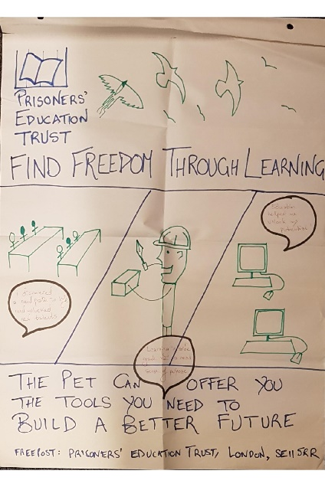
PET’s PAC workshop:
Learning from our learners
Workshops in HMPs Coldingley, Send and Spring Hill
Facilitated by CJ Burge, a PET alumna & St Giles’ Trust SOS+ Project Manager
Overall aim:
“How can we improve our distance learning offer so that it works for you?”
Outcome:
Participants’ views are helping us improve the way we fund courses and support learners
Impact:
Development of communication, problem-solving & conflict resolution skills, and of social capital

Slide 13
Activity resources
1. Active citizenship audit
Mapping what is already going on in your prison concerning prisoners’ active citizenship
2. Deciding your aims – key questions
Thinking about the end goals of your active citizenship project
3. Outcome planning tool
Identifying your aims, defined for each person and organisation involved in your project
4. Participatory project planning
Designing the project by taking into account the perspective of every audience

Slide 14
Activity resources
5. Support matrix
Meeting with stakeholders to consider their goals and concerns
6. Bias check
Taking away possible resistance to co-production and collaboration
7. Shared values
Co-producing values for your own active citizenship project in prison
8. Ideas for monitoring activities
Establishing the measurement tools you use to decide whether your project is a success

Slide 15
What’s next?
Will the project be able to continue?

Slide 16
How to access resources
To download a printable PDF of the Toolkit, please visit:
prisonerseducation.org.uk/what-we-do/policy/active-citizenship-in-prisons/
Coming soon to the webpage
Downloadable activity worksheets
The PAC project report researching the evidence base for active participation
The PAC team's set of policy recommendations for governments across Europe

Slide 17
Citizens Inside toolkit: exercises
Completing four exercises from the Citizens Inside toolkit
Form groups of four - try to be in a group with different organisations
The exercises:
Deciding your aims
Outcome planning tool
Levels of participation
Basic conditions

Slide 18
Deciding your aims – exercise 1
Thinking about the end goals
of your active citizenship project.

Slide 19
Outcome planning tool – exercise 2
Identifying your aims, defined for each person and organisation involved in your project, and helping measure the success of your project.
Complete at least one full audience row

Slide 20
Levels of participation – exercise 3
What would different levels
look like for your project?

Slide 21
Basic conditions – exercise 4
What issues might you face? How could you overcome them?
Time
Location
Resources
Support of staff
Prisoner support
Language
Security
Communication
Difference in feelings and approach to prison life topics

Slide 22
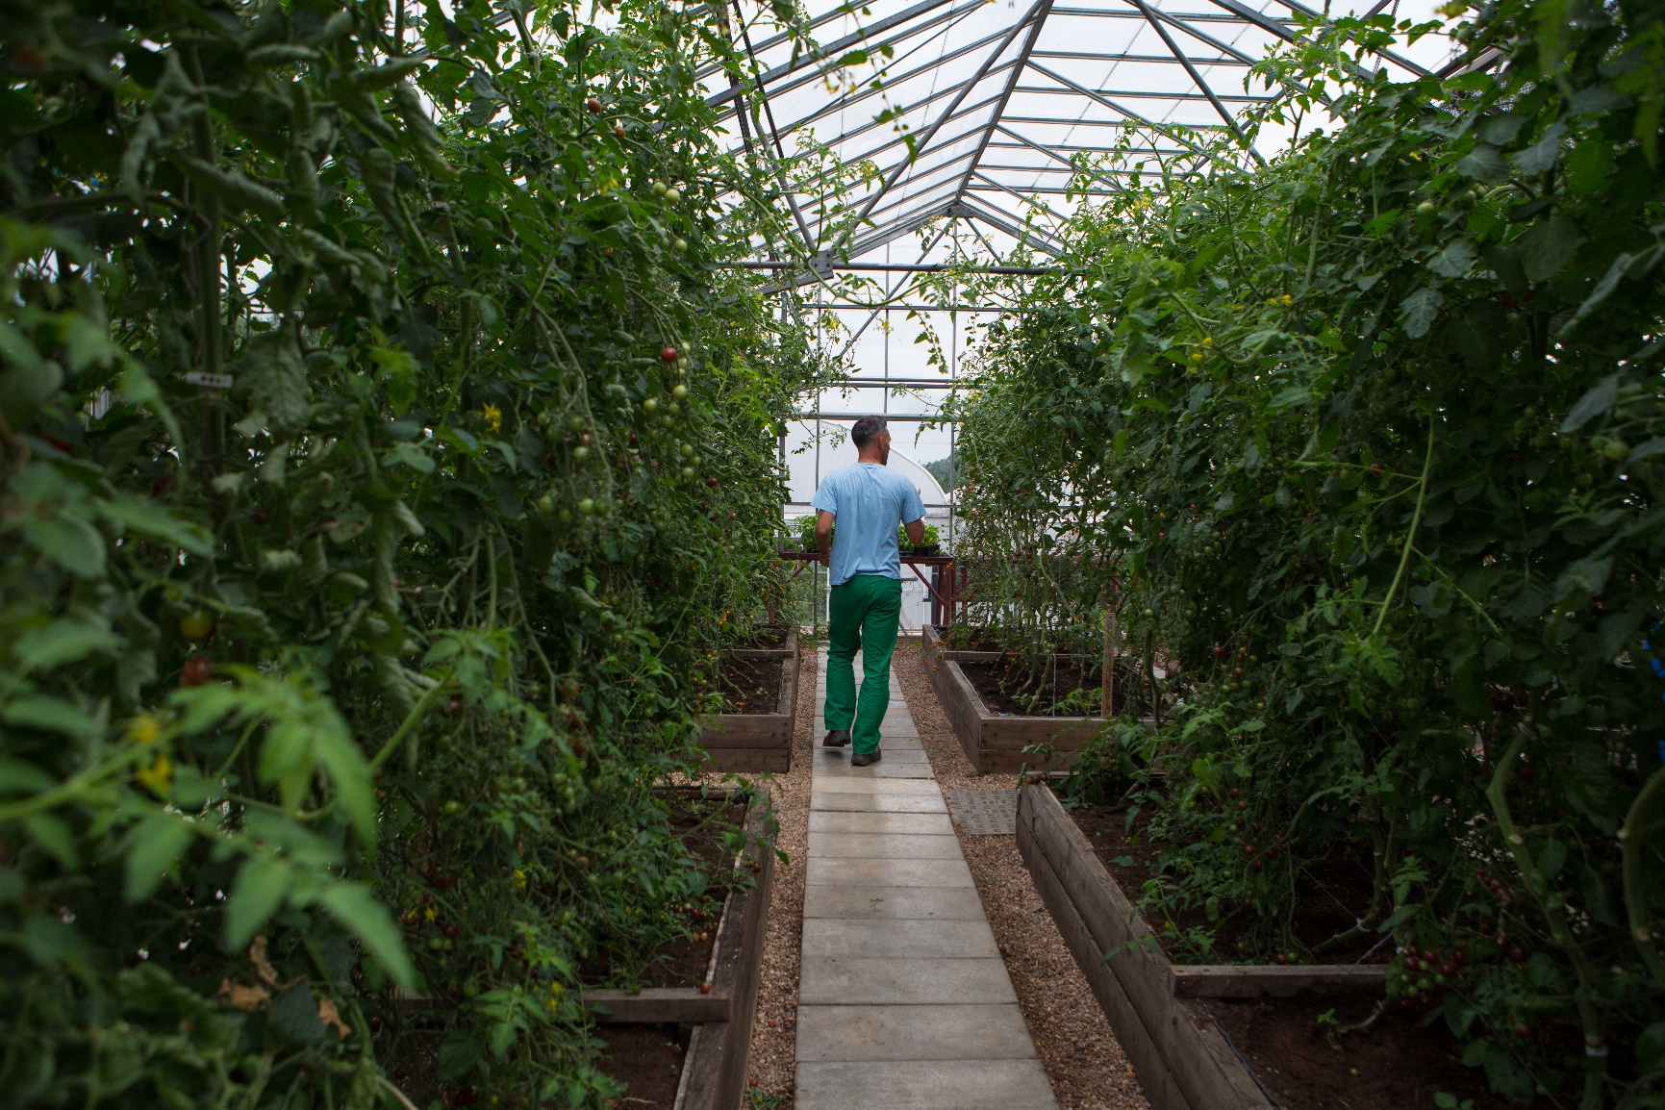
Thanks for listening
Any questions?
Ha ha!!
Transforming lives through education
@PrisonersEd
www.prisonerseducation.org.uk

