Slide 1
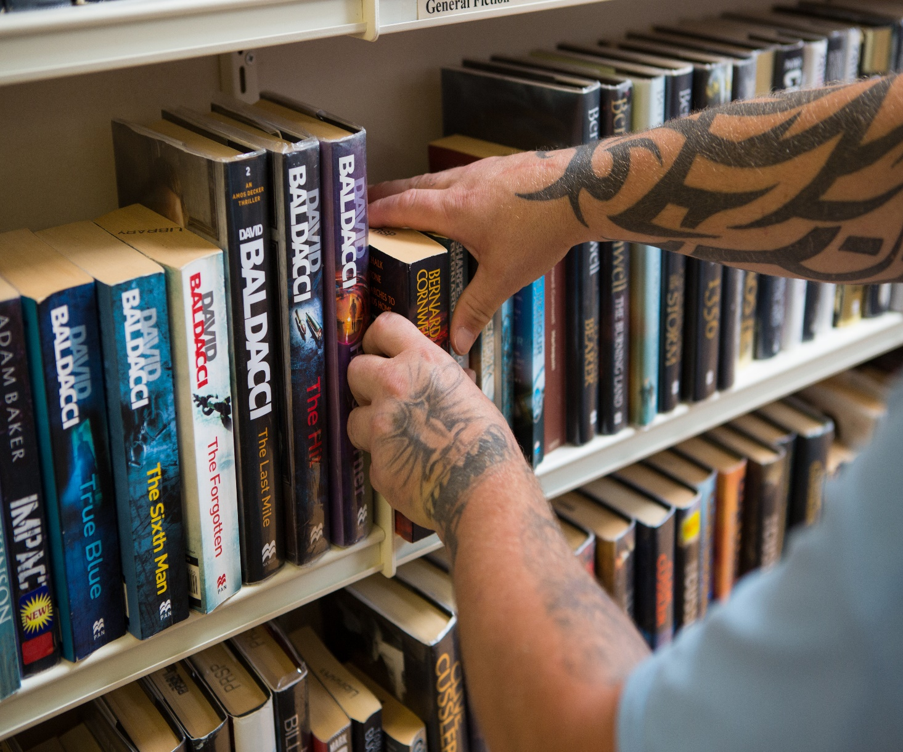


PAC workshop:
Learning from our learners
Rod Clark & Calum Walker
Prisoners’ Education Trust
Transforming Lives through Education
Ha ha!!
Transforming lives through education
@PrisonersEd
www.prisonerseducation.org.uk

Slide 2
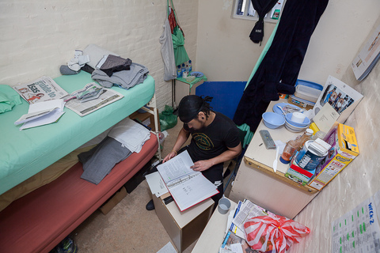
Prisoners’ Education Trust
30 years – funding prisoner learners over 40,000 times.
Distance learning courses NVQ to degree level & advice
Policy
Influence
Research

Slide 3

Theory of change
PET has never adopted an exclusively employment related view of the value of education

Slide 4
PET’s PAC workshop:
Learning from our learners
Workshops in HMPs Coldingley and Send
Facilitated by CJ Burge, a PET alumna & St Giles’ Trust SOS+ Project Manager
Aim of the project:
To develop an understanding of how the use of learner forums can help develop and improve the delivery of PET services in prisons
The key question for participants:
“How can we improve our distance learning offer so that it best helps you meet your learning objectives?"

Slide 5
Outputs
Innovative workshops across two prisons
Initial and end participant questionnaires
Focus groups with participants
A meeting to outline the outcomes & recommendations from the project

Slide 6
Planning the project
20 days
Planning, delivery, questionnaires and focus groups, follow up meetings to capture learning for PET
Alumni Advisory Group - asking them about facilitation experiences

Slide 7
Project participants
Current PET learners
Potential learners
Minimum 1 current prison council member

Slide 8
Workshop 1
What do the participants know about PET
Views on our promotional materials
Initial questionnaire

Slide 9
Workshop 2
What do you use distance learning courses for?
What do you value in a course? What qualities make for a good distance learning course?

Slide 10
Workshop 3
What could PET offer in addition to DL courses?
Where are the gaps/sticking points in learning journeys at the moment and how does PET fill this?
A final questionnaire
A focus group held to discuss how the workshops went

Slide 11
Lessons
“When the group came up with questions, we always tried to make sure that we had something to reply to them between sessions, for instance ‘We took your question to this person, and they said this…’ That really worked well and built trust between us and the group.”
Prisoners’ Education Trust

Slide 12
The focus group
What were your expectations at the start?
What went well?
What did not go well?
What did you learn during this activity that could be of use here in prison?
What did you learn during this activity that could be useful for your return to society?
How could this become a 10 out of 10 experience?

Slide 13
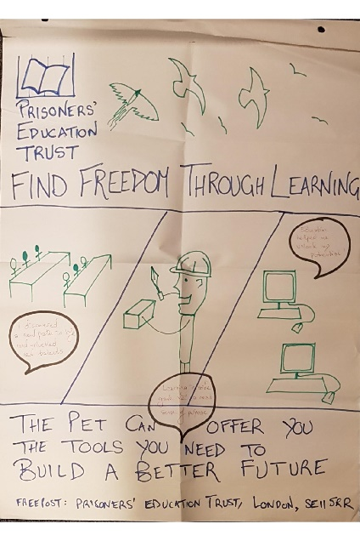
What we found out
Learners said
PET is not widely known enough
Suggested solutions
Create eye-catching posters and leaflets, with ‘aspirational’ messages focused on hope and progress
Train peer mentors to promote opportunities
Mention PET in inductions

Slide 14
What we found out
Learners said
It can be hard to understand how funding decisions are made
Suggested solutions
Share clearer information with learners and staff on our website, leaflets and posters
Speed up the application process

Slide 15
What we found out
Learners said
Learners sometimes lack information about courses
Suggested solutions
Produce a digital curriculum that prison staff can search and print for learners
Provide more information about how certain courses can lead to work, with success stories
Ask learners to review courses, with possible rating system

Slide 16
Outcomes and impact
Outcome:
Participants are helping us improve the way we fund courses and support learners
Impact:
Influence over our work
Skills - communication, problem-solving and conflict resolution
Social capital - part of a community, influence over surroundings

Slide 17
Outcomes and impact
“It was amazing for me to go into these prisons and see the real passion there was among the men and women learning there. There was so much untapped enthusiasm to contribute to PET’s work, and to come up with solutions – really creative and far-sighted solutions – to some of the barriers that can occur with education.”
CJ Burge, workshop facilitator

Slide 18

What’s next?
Short term:
New materials, a new website, and introducing a clearer way to apply.
Long term:
Involve peer mentors and digital courses – watch this space!

Slide 19
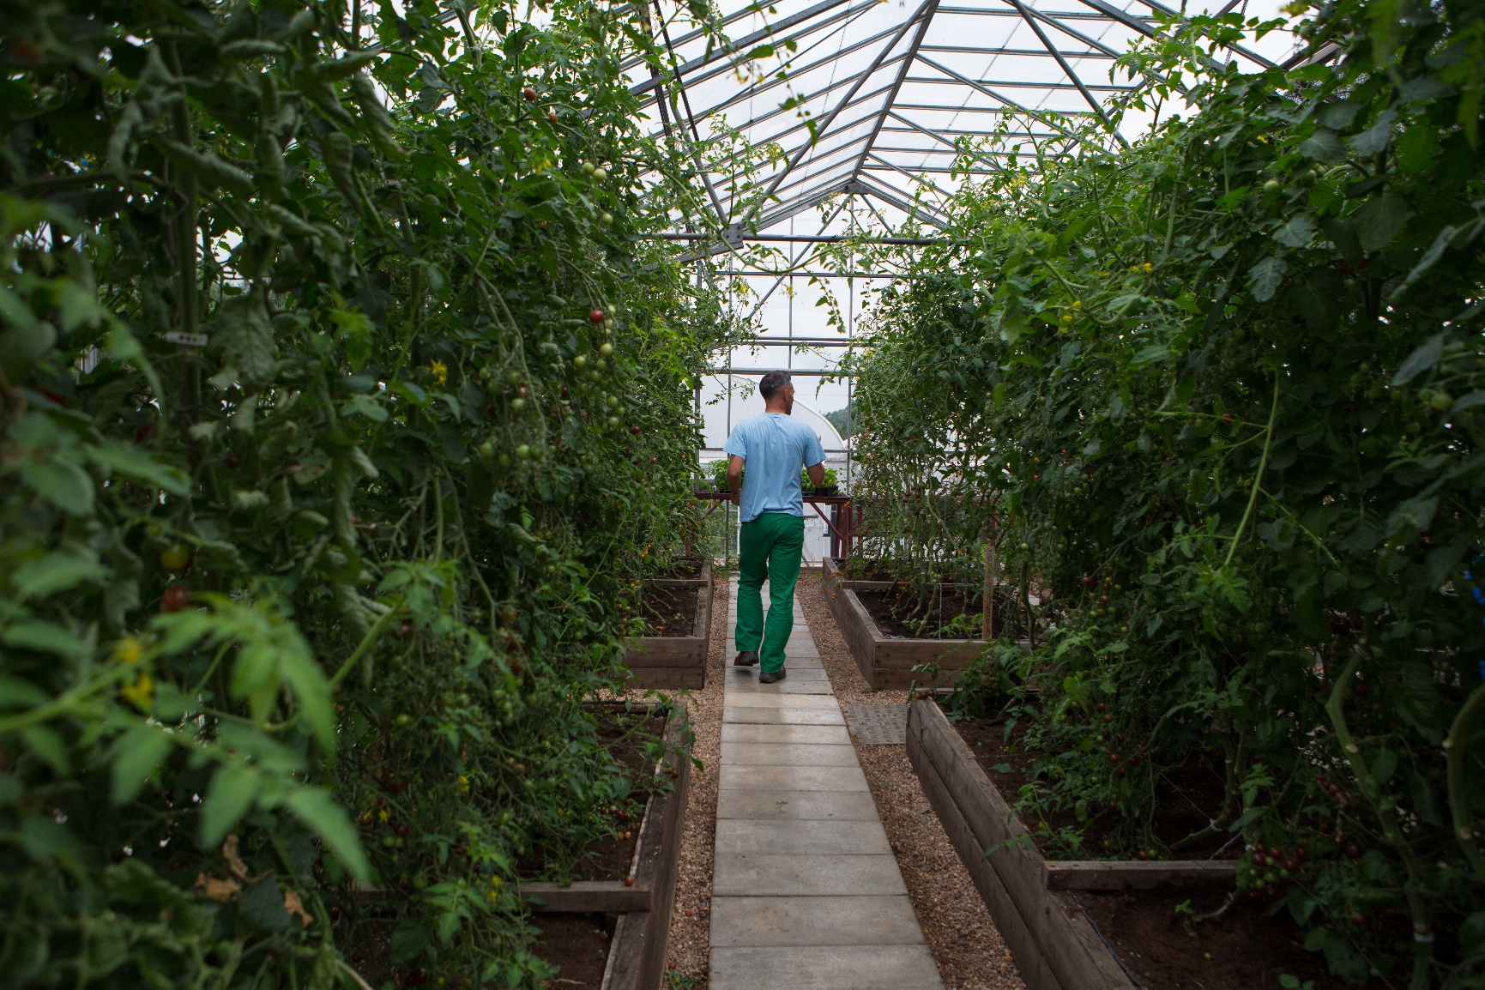
Thanks for listening
Ha ha!!
Transforming lives through education
@PrisonersEd
www.prisonerseducation.org.uk

